Slide 1
Dear reader,
This is a strategy slide deck I contributed to while I was working in China. This was made in May of 2025 when the trade war with China had subsided from the 135% tariffs that had been in affect only a few weeks prior. Factory workers had just come back to work and the factory was nearly at full production.
This slide deck was presented to the board to determine a strategy for cultivating less exposure to the US market especially when the future remains uncertain.
I wanted to upload this deck to show my experience in working in high-pressure, high-stakes environment when sound analysis is critical to success.
While this is old information, I’ve redacted all potentially sensitive information.
- Grant W. Corbett

Slide 2

Agenda
Part 1 | Problem Statement and Solution Options
Part 2 | Leased Lines (Pros + Cons)
Part 3 | Commercial analysis of Leased Lines
Part 4 | Further Considerations and Next Steps

Slide 3
Challenges have arisen with the change in business model from Longson in-house to COO outsourced production.
Immediate Challenges
Sourcing smaller orders <800 pcs
COO partners either refuse or quote very high prices (2-3 times normal)
Long-Term Challenges
Owning production has always been AAG’s strategic edge and a key selling point
Owning factory provides flexibility, control, and appeal to customers
Guarantee capacity, secure new orders
Current production situation is in transition, AAG struggling to confirm location and timing of future orders (cf: LeverStyle and SGroup)
Value Added Processes in AAG hands
Ability to quote and manage more complex product for customers. In COO partner country, close to supply base.
Technical capabilities
Partner inability / reluctance with complex technical capability, especially value-added processes
Country Diversification
Potential for 46% and 49% reciprocal tariffs on Vietnam and Cambodia (+ geopolitical risks)
Uncertainty
Partners' uncertainty about us, and our uncertainty about partners and customers.
Consolidate Footprint
Manage resources more efficiently

Slide 4
There are a range of options each with pros and cons. Leased lines / capacity is a middle ground between Longson and COO outsourced partners.
Leased Lines and Capacity
Outsourcing - COO
AAG Wholly Owned
Pros
Pros
  Taking advantage of existing factory’s infrastructure and facilities
  Limited CAPEX
    May shift CAPEX
  Partner pays OPEX
  AAG controls Lease line
  Allows for deeper partnerships
    Maybe future VAP, equity options
Pros
Zero CAPEX
  May shift capex
Very small OPEX commitment
Allows for all categories of product through large supply base
Diversification of supply-base risk
  Complete control over production
  Allows planning, training flexibility
  High sales confidence
  Asset based model
Cons
Cons
Cons
Limited control over capacity
Partners pick and choose orders
Many categories, many suppliers needed
Small MOQs - small orders impossible
  Highest CAPEX and Risk
  Lots of time and resources
  High costs to manage many product ranges on single site (Longson)
  Long term capacity is in the hands of partners, not AAG
  AAG will pay the cost of lower efficiency, we’ll need to invest
Low CAPEX, Low Control
Right Amount of Control and Upfront Costs
High CAPEX, High Control

Slide 5
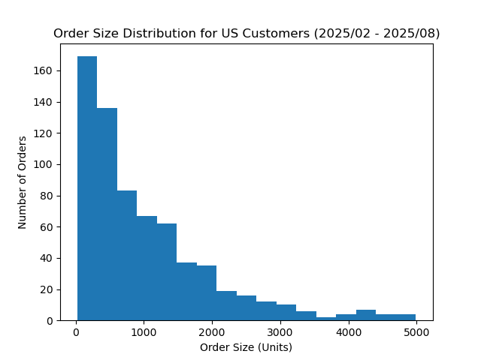
More than half of US customers POs are less than 800 pieces. We urgently need a solution to place these small orders as they are a huge part of AAG’s business.
Product | % Below 800 pcs
HOODIES | 30%
LEGGINGS | 41%
JACKET | 48%
SHORTS | 55%
DRESS | 78%
Customer | % Below 800 pcs
Greyson | 68%
Bad Birdie | 72%
Spirit. Gang. | 61%
Peloton | 26%
ALWRLD | 95%
Difficult to source smaller orders <800 pcs
COO partners either refuse or quote very high prices of 2-3 times normal rate
Timing and Geopolitical Climate Makes
Challenges more Complex
  Outsourcing factories at capacity due to anticipatory tariff orders
  General move out of China puts suppliers and potential partners in the driver’s seat
    They can cherry-pick customers

Slide 6
Agenda
Part 1 | Problem Statement and Solution Options
Part 2 | Leased Lines (Pros + Cons)
Part 3 | Commercial analysis of Leased Lines
Part 4 | Further Considerations and Next Steps

Slide 7
Leasing Lines = securing access to existing capacity (facilities, machines, labor) that works under the direction of AAG (responsible for production outcomes)
Ideal Partner
Leasing Details
Partner Compensation
In an ideal world…
~500 Workers in Size
Capacity paid for by actual cost + model
  Sales value from the lines production accrue to AAG to offset the costs
Margin to the partner is either on a cost + fixed margin or on a variable margin depending on Cut Make Profit from the line (All Negotiable)
  Partner has space for expansion, not leasing lines from capacity
  We’ll concentrate at least 2 lines in one location
    depending on the range of categories the site can make (more lines is better)
  AAG can place small or big orders on those lines as required by demand
Looking for a long-term partnership
Does not have any strong development or sales functions
Located in a geographic hub
for supply chain effectiveness and management ease
  Leased lines would be in COO Partner facilities with a preference that partner is also a COO partner (producing larger orders)

Slide 8
The concept, put into lower cost countries allows development of small order expertise as well as access to flexible capacity without high up-front costs.
Pros
  Taking advantage of existing factory’s infrastructure and facilities
  Limited CAPEX
    May shift CAPEX from Longson
  AAG has control over the capacity enabling small orders production or larger order commitment as required
  No AAG entity required in new country to start
    Need to examine regulatory framework (e.g. Trading entity for Import/export purposes
  Provides a deep partnership which may allow for future equity, JV, higher control, or expansion into VAP
  Speed to start production
  Can locate lines in more than one country diversifying risks
Cons
  Most partners focus on 2-3 categories within a factory – AAG has many categories and may need leased lines in 3+ locations
    High support costs
    Management of orders onto those lines
  Small orders have high sample and merch requirements; therefore, partner will have high costs and will be carried onto AAG
  Capabilities built on these lines will be shared with partners, build competition?
  AAG would need to place expertise on site
    High personnel costs
  Long term capacity is in the hands of partners, not AAG
  AAG will pay the cost of lower efficiency, we’ll need to invest
Risks and cons can be mitigated effectively. No detrimental concerns that constitute a knockout.

Slide 9
Agenda
Part 1 | Problem Statement and Solution Options
Part 2 | Leased Lines (Pros + Cons)
Part 3 | Commercial analysis of Leased Lines
Part 4 | Further Considerations and Next Steps

Slide 10
We’ve received estimates from Cherry in Cambodia for costs of running 2 lines, but we think they’re high. We’re confident that the cost for 2 lines will be ~$60K.
Internal Estimates 2 Lines Cambodia costs
Cherry Cambodia for 2 lines
$36,000
$2,600
$8,000
$6,500
$5,000
Total Costs for 2 lines at capacity per Month $58,000
Therefore, we’re confident that $60K is a reasonable cost estimate for 2 lines with a partner
Total $71,000
Important Notes about Production Costs
Incremental lines are assumed to have lower costs as fixed costs are further absorbed
Cherry difference in very high DL to IDL ratio of 1:1 – this excludes Merch, Sales and other
There will be a ramp up period for lines to be trained where costs are higher and efficiency lower
AAG will need to provide expert advice on site to develop the line’s capability quickly

Slide 11
Leased lines appear to be a viable option based on our estimates on a monthly basis and their positive contributions will help pay for fixed costs at Longson.
Product Category | Avg. CM Income per SAH | Avg. GSD SEWING | CM / pc | Estimated Efficiency | Pcs / Mo. | Income | LLs Cost | CM to LS Fixed Costs
JACKET | $22.76 | 48 mins | $18.06 | 30% | 4.9K | $89K | ($60K) | $29K
LEGGINGS | $28.00 | 14 mins | $6.38 | 33% | 19K | $121K | ($60K) | $61K
SHORTS | $18.49 | 29 mins | $9.05 | 24% | 6.2K | $57K | ($60K) | ($3.3K)
SWEATTOP | $29.81 | 28 mins | $14.04 | 37% | 10K | $142K | ($60K) | $82K
Analysis is based on 2 leased lines

Slide 12
Since we don’t have access to lease line partner’s production data, we’ve had to make confident assumptions to evaluate the viability of operating leased lines.
Calculation Assumptions
Data is based on orders of <800 pcs for American customers ONLY
Calculated based on a representative data set of the population.
Estimated Efficiency for Category on LL = Longson Efficiency – (0.3 x Actual Longson Efficiency for Category at <800 pcs)
Estimated Cost per line ($30,000) calculated based on estimates from Cherry and other COOs
The Contribution calculated on the previous page is NOT profit from lease lines. This is contribution toward Longson’s fixed costs. It’s how the costs were calculated in this example.
Assumes we’re able to fill a line, for a whole month, on a single product category, at full capacity
Capacity Assumptions
Operators per Line | 25 ppl
Working Hours / Day | 10 hrs
Working Days / Month | 26 days
Total Working Minutes (2 lines) | 780,000 mins / mo.

Slide 13
As a reality check: like for like production at Longson Vs Partner we can see the lower personnel costs in partners offset lower efficiency giving better CM to fixed margin.
Longson average actual operations costs per month are $2,543K spread over 42 sewing lines
Includes costs for Cut/Sew/ Finish and Warehouse and QC, Production Management
Excludes SGA, COO, Sample Room
There will be additional LS expert costs to help partners start production

Slide 14
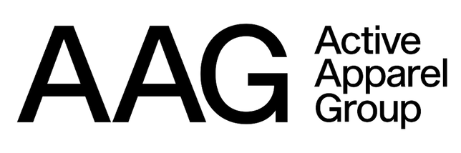
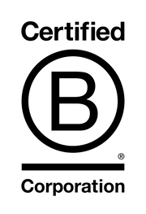
Agenda
Part 1 | Problem Statement and Solution Options
Part 2 | Leased Lines (Pros + Cons)
Part 3 | Commercial analysis of Leased Lines
Part 4 | Further Considerations and Next Steps

Slide 15



Initial partner location will focus on 3 countries to hedge against tariff issues. However, the Philippines are our priority with best the overall long-term opportunity.
 | Population Fertility | Potential Trump Tariff | Worker Cost | Annual Increases | Apparel exports 2024 | World Bank Unemployment
Philippines | 115M / 1.9 | 17% | $300-$350 | 5.5% | $1.4bn | 3.8%
Cambodia | 17M / 2.6 | 49% | $400- $450 | 6% | $13.7bn | 0.27%
Vietnam | 100M/ 1.9 | 46% | $430-$500 | 6-7% | $44bn | 2.24%
Pros
Cons
Best overall long-term diversification option vs. China, geopolitically - not a “hot” market Open capacity in right-sized partners available Visited factories have low turnover, good skills, and relative ease of hiring Sufficient concentration of potential partners in locations to allow for sourcing effectiveness | Less developed ecosystem for supply chain, fabrics, trim etc. Longer lead times to and from China and to the USA with fewer sailings Overall less experienced in the garment industry
Proximity to China for sourcing and large numbers of Chinese factories in both countries Vietnam is building sophisticated supply chains FTA in place for EU, though Cambodia has issues to maintain. Vietnam large variety of FTA | Costs are rising faster in both due to fast industrialization and new FDI Tight labor markets Partners in both countries have options and are in a position of strength and thus harder to deal with

Slide 16
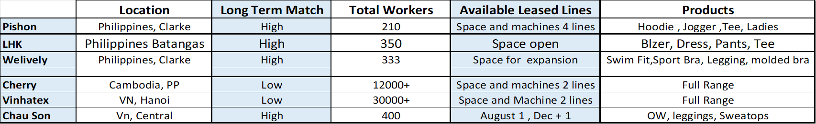
We have 3 potential partners with demonstrated interest in supporting 2 lease lines. The Philippines is our priority, but we’ll continue to negotiate with Vietnam and Cambodia.
 | Company A | Company B | Company C
Pros | 7 vacant lines "Zero" tax from import and export because within Clark freeport zone Good house-keeping, 5S, and environment High security level, health, and safety Close to Clark international airport, 15-20 mins drive | Spare building, opportunity to expand "Zero" tax from import and export Laser-cutting machine, molded bra machine, heat transfer label machine High security level, health, and safety It has 2 factories in the Philippines and it has US customer Wrap certification | It has spare capacity opportunity to work with AAG for order allocation Product diversification, factory can do a variety of product types in sample and bulk Good house-keeping, 5S, and environment Lower labor wages rate low because rural area With US Customer Wrap Certification
Cons | Limited & basic machineries, no laser cutting, auto cutting, bonding Small sample room, less sewing workers and using manual pattern. No US customer No Wrap Certification | Sewing production floor is narrow limits production to low SMV types housekeeping issue, messy sewing area Relatively simple product types and range Management has no sense of urgency | Limited & basic machinery, no special machines like laser cutting, auto cutting, bonding, seams-sealing, etc. Facility is less secure because rural area Embro, printing sub-con partner is too far from the factory. 1.5 - 2hrs from Manila International airport

Slide 17
We will plan to present non-binding MOU to potential partners and align with anchor customers.
Key next steps
  Complete the MOU discussions with Philippine based suppliers
  Negotiating transparent cost and incentive structure with potential partners looking for a win-win
  Developing business and operations plans with partners: hiring, skills, layouts, training, planning etc.
  Build AAG lean plan for small order lines effectiveness
  Identify AAG expertise to support lines and build into GSS structure and budget
  Work back through the risks identified and assure actions in place

Slide 18
Appendix : Headcount Assumption

